Slide 1
Stage 4: Designing a healthy recipe

Slide 2
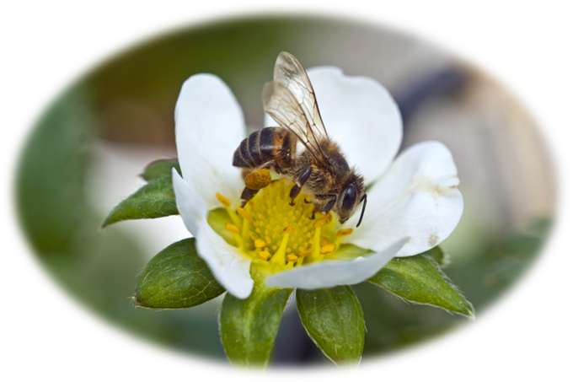
To help us set up our farm shop business, we need to learn about where our food comes from and how to make sure we make a food product that will help our customers to have a healthy, balanced diet.
Talk to your group: what ingredients can we grow ourselves?

Slide 3
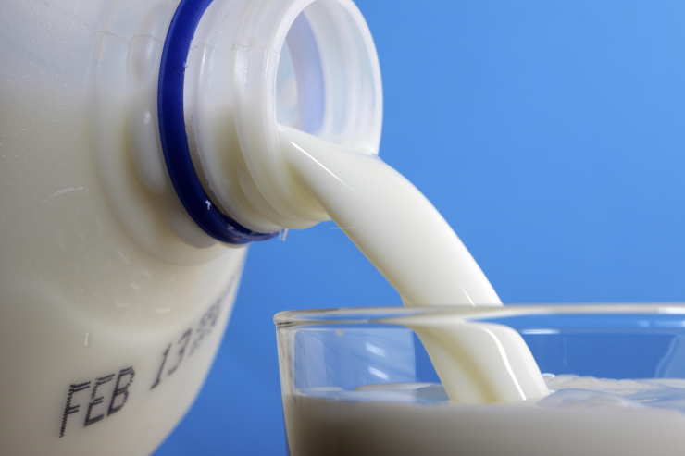
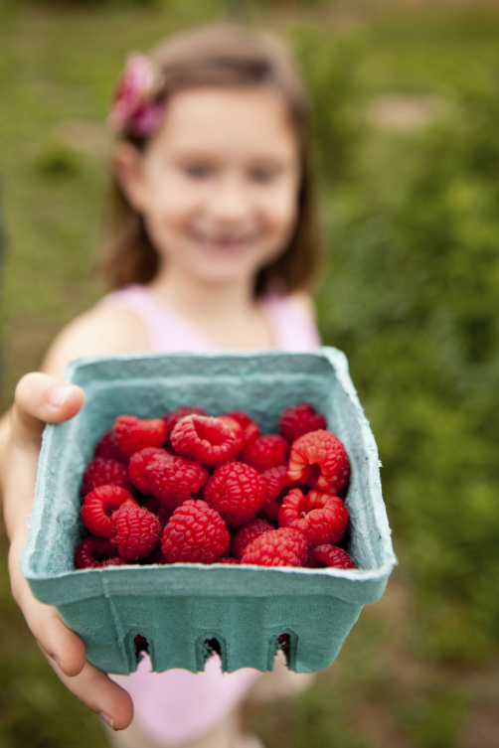
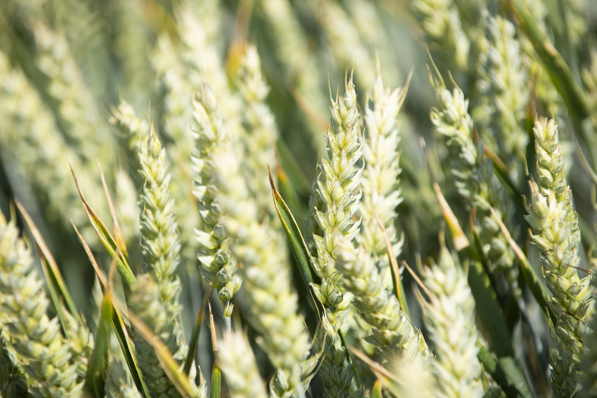
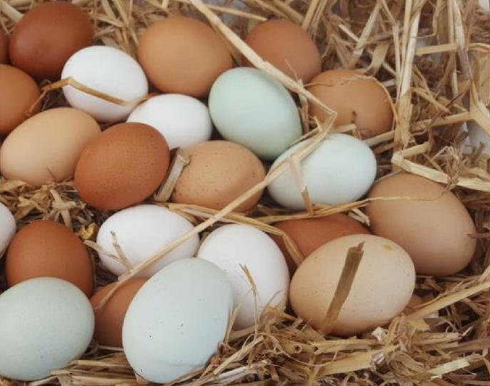
Which ingredients can we grow ourselves?

Slide 4
Many fruit and vegetables can be grown in this country from seeds.
Talk to your business group: can you name any?
Why can’t we grow all types of fruit and vegetables in the UK?

Slide 5
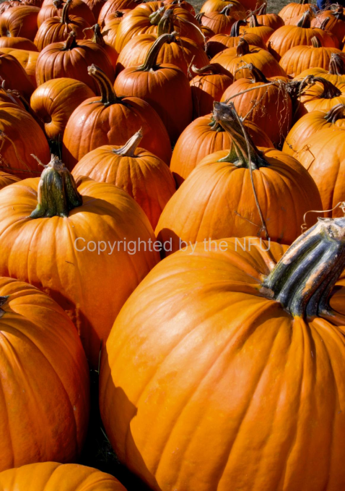
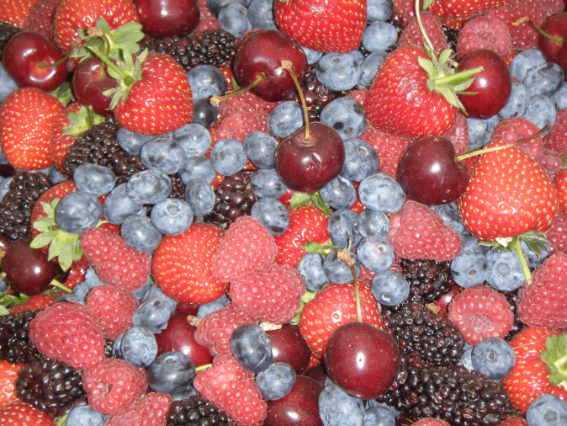
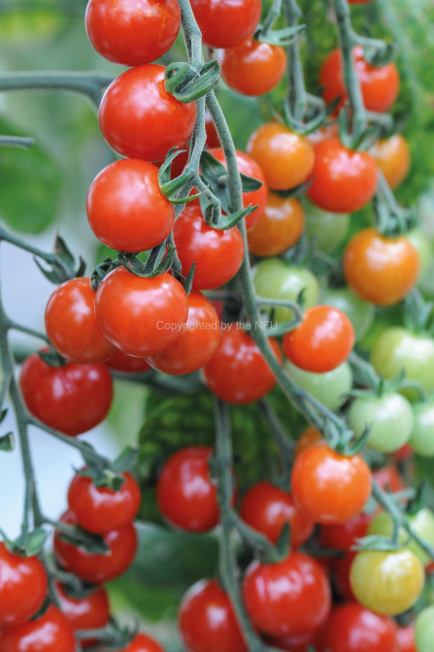
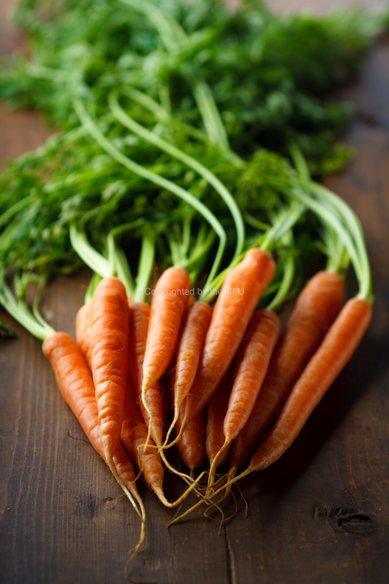
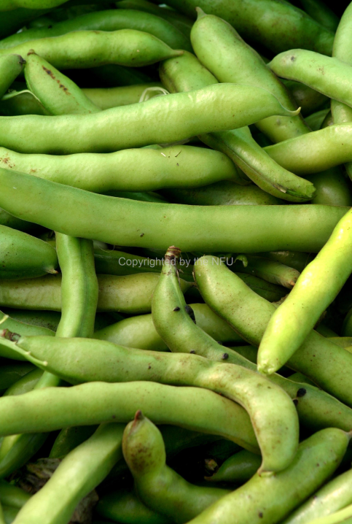
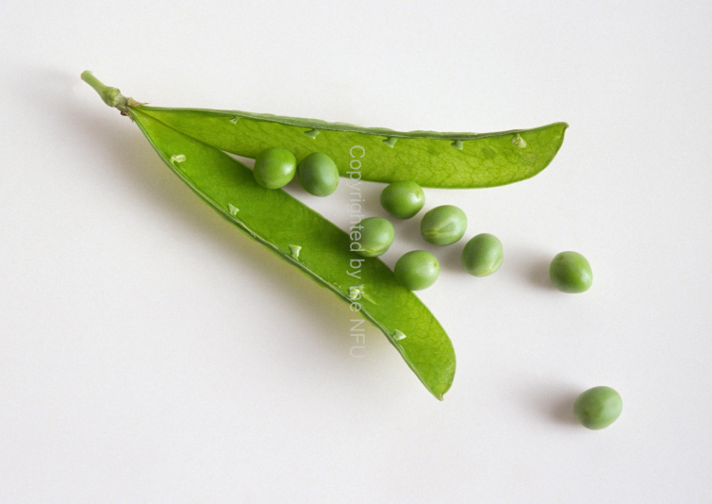
British fruit & vegetables grown from seeds:
Lettuce
Tomatoes
Radishes
Carrots
Beans
Peas
Spinach
Pumpkins
Cucumbers
Radishes
Strawberries
Blackberries
Rhubarb

Slide 6
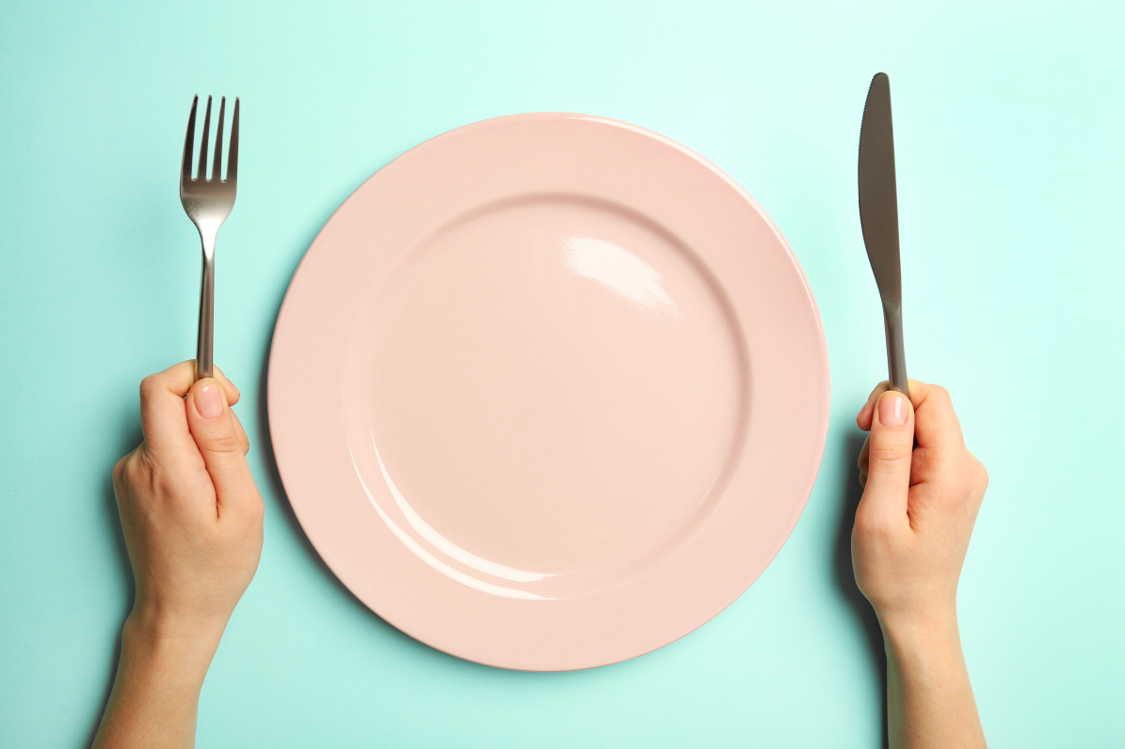
Learning Objective:
To design a healthy recipe
Talk to your partner: what can you remember about healthy eating?
What sorts of food do we need to include in our healthy lunchtime food product?

Slide 7
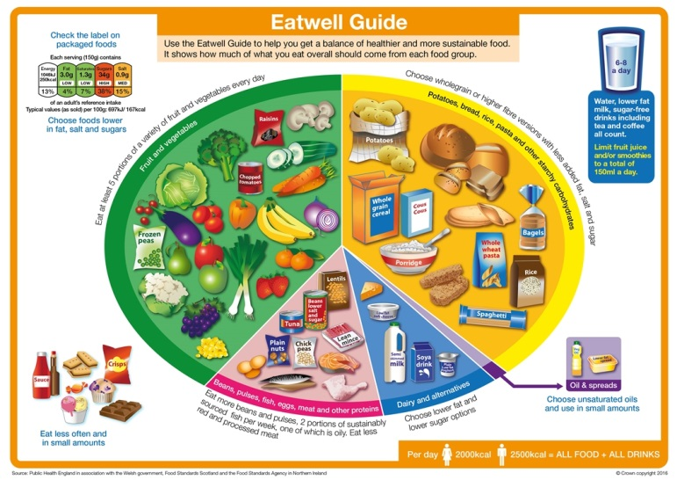
The Eatwell Guide
The healthy eating model for the UK is called the Eatwell Guide.

Slide 8
We should choose a variety of different foods from each food group to help the body get everything it needs to stay healthy.
We should eat foods in the proportions shown on the Eatwell Guide, e.g. lots of foods from the largest two food groups.

Slide 9
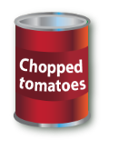
Fruit and vegetables
Fruit and vegetables should make up just over a third of the food we eat each day.
Aim to eat at least five portions of a variety of fruit and vegetables each day.
As a guide, a portion is what fits into the palm of our hand.
Choose from fresh, frozen, canned, dried or juiced.
Remember, 150ml glass of fruit juice or smoothie counts as a maximum of one portion a day.
What foods can you see here?

Slide 10
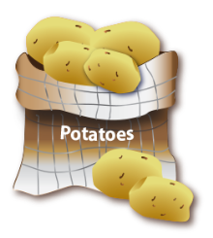
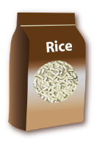
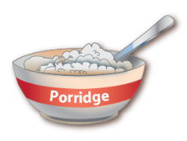
Potatoes, bread, rice, pasta and other starchy carbohydrates
Starchy food should make up just over a third of the food we eat.
Base your meals around starchy carbohydrate foods:
- have wholegrain breakfast cereal;
- have a sandwich for lunch;
- have potatoes, pasta or rice as a
base for your evening meal.
Try to choose higher-fibre, wholegrain varieties such as wholewheat pasta, brown rice, or simply leave the skins on potatoes.
What foods can you see here?

Slide 11
Beans, pulses, fish, eggs, meat and other proteins
Eat some foods from this group.
Beans, peas and lentils (pulses) are good alternatives to meat because they’re naturally very low in fat, and they’re high in fibre, protein and vitamins and minerals.
Choose lean cuts of meat and cut off any visible fat.
Grill meat and fish instead of frying.
Aim for at least two portions (2 x 140g) of fish a week, including a portion of oily fish.
What foods can you see here?

Slide 12
Dairy and alternatives
Have some milk and dairy food (or dairy alternatives) such as cheese, yoghurt and fromage frais.
These are good sources of protein and vitamins, and they’re also an important source of calcium, which helps to keep our bones strong.
Go for lower fat and lower sugar options. For example, try:
- semi-skimmed milk;
- reduced fat cheese;
- going for unsweetened, calcium-fortified versions of dairy alternatives.
What can you see here?

Slide 13
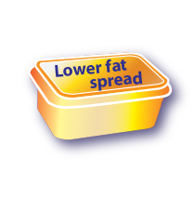
Oils and spreads
We only need a little fat for health (generally, we are eating too much saturated fat).
Unsaturated fats are healthier fats that are usually from plant sources and in liquid form as oil, for example vegetable oil, rapeseed oil and olive oil.
Choosing lower fat spreads is a good way to reduce saturated fat intake.
Remember, all types of fat are high in energy and should be
limited in the diet.
What foods can you see here?

Slide 14
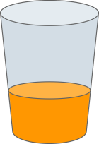
Hydration
Aim to drink 6-8 glasses of fluid every day.
Water, lower fat milk and sugar-free drinks all count.
Fruit juice and smoothies also count although they are a source of free sugars so you should limit them to no more than a total of 150ml per day.
What might be good drink choices?

Slide 15
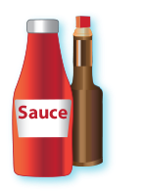
Foods high in fat, salt and sugars
Foods like chocolate, cakes, biscuits, full-sugar soft drinks, butter and ice-cream are not needed for health.
If foods like these are eaten or drunk, it should only be occasionally and in small amounts.
Check the label and avoid foods which are high in fat, salt and sugar!
What can you see here?

Slide 16
Key message summary
Eat at least 5 portions of a variety of fruit and vegetables every day.
Base meals on potatoes, bread, rice, pasta or other starchy carbohydrates; choosing wholegrain versions where possible.
Have some dairy or dairy alternatives (such as soya drinks); choosing lower fat and lower sugar options.
Eat some beans, pulses, fish, eggs, meat and other proteins (including 2 portions of fish every week, one of which should be oily).
Choose unsaturated oils and spreads and eat in small amounts.
Drink 6-8 cups/glasses of fluid a day.
If consuming foods and drinks high in fat, salt or sugar have these less often and in small amounts.

Slide 17
Seasonality and Lifecycles
Different fruit and vegetables grow and can be harvested at different times of the year. When designing our recipes, we need to consider which vegetables will be readily available at this time of year.
Eating foods when they are in season means that we can support British farmers and growers by buying their produce.
If we want to buy food that is not in season in Britain, it has to be imported from other countries. The further our food travels, the more of a negative impact it has on the environment.

Slide 18
Your task
With your group, brainstorm ideas for healthy fillings that you could add to your tartlet or breakfast drink.
Think about the nutritional requirements that need to be met and consider seasonality.

